Slide 1
RIA
Risk Intelligence Agent
The Business Control Tower for Microsoft Dynamics 365 Business Central
Gokulnath Sundaramoorthy
Senior Lead Consultant — Microsoft Dynamics 365 Business Central
Version 1.0 · June 2026

Slide 2
WHY THIS APP?
01
Risk Surfaces Too Late
The ERP
Intelligence Gap
Payment discrepancies, control exceptions and approval gaps are discovered months after the business impact has occurred
02
Audit Readiness Gaps
No predictive view of the control environment's health — until the review team is already at the table
Business Central captures every transaction — yet answers none of the critical questions facing your CFO, Controller or Audit Director.
03
Silent System Drift
A single ERP configuration change can silently affect thousands of subsequent transactions with no detection mechanism
controls built to answer them
04
Reactive Financial Operations
Credit provisions, margin erosion and compliance exposures are consistently confirmed only after the fact
05
No Forward-Looking Visibility
Business Central records every transaction but provides no predictive intelligence on emerging financial risk

Slide 3
INTRODUCING RIA
The Business Control Tower
Proactive · AI-Powered · Continuously Monitoring · Business Central-Native
What is RIA?
Five Intelligence Layers
RIA transforms Microsoft Dynamics 365 Business Central from a passive transaction processor into an active, five-layer intelligence platform — monitoring financial integrity, operational performance, regulatory compliance and strategic risk continuously.
L1 Transaction Intelligence
44 controls · Finance, AP, AR, Inventory, Mfg, Projects, FA, Master Data
L2 Process Intelligence
P2P · Q2C · R2R · Plan-to-Produce · Intercompany · Project-to-Cash
Designed For
L3 Configuration Intelligence
CFO & Finance Directors
Posting Setup · Approvals · SoD · Number Series · Change Log
Financial Controllers
L4 External Market Intelligence
Currency movements · Supplier health · Customer signals · Regulatory updates
Internal Audit Teams
L5 Predictive Risk Intelligence
Procurement & Supply Chain
Cash flow · Default probability · Inventory shortage · Margin trajectory
BC System Administrators
Gokulnath Sundaramoorthy · Microsoft Dynamics 365 Business Central Solution Architect

Slide 4



CUSTOMER BENEFITS
Measurable Business Value
Quantified returns from early risk detection, audit efficiency and compliance confidence
5×
40%
>90%
Annual ROI
Audit Time Saved
Early Recovery Rate
Average return from risk detection, audit preparation savings and payment recovery
Reduction in time to prepare for external review through automated evidence packaging
Detection-to-recovery rate vs. under 30% when exceptions surface late
30%
24h
7
Faster Period Close
Time to First Alert
Country Frameworks
Automated close checklists and exception management cut the cycle time
Active on first risk alert within 24 hours of product activation
Built-in compliance for SOX, MTD, GST, ZATCA and more, updated within 30 days
Gokulnath Sundaramoorthy · Microsoft Dynamics 365 Business Central Solution Architect

Slide 5






CORE FEATURES
Eight Intelligence Capabilities
Configurable, evidence-first and continuously active across Business Central
100+ Intelligence Controls
Audit-Ready Evidence Packaging
Configurable rules across all 8 BC domains — Finance, AP, AR, Inventory, Manufacturing, Projects, Fixed Assets, Master Data
Structured packages formatted for external review — SOX, GDPR, GST, ZATCA and Big 4 audit methodology templates
6 Role-Specific AI Copilots
No-Code Configuration Engine
Risk, Audit, Finance, Supply Chain, Executive and Compliance Copilots — each grounded in your actual BC data via GPT-4o + RAG
Every control, threshold and escalation path configurable by business users — zero development effort required
External Market Intelligence
Zero ERP Performance Impact
Currency movements, counterparty health signals, customer
credit changes and regulatory updates connected to your ERP positions
Asynchronous Azure processing via BC REST APIs ensures guaranteed zero impact on ERP transaction throughput
Predictive Intelligence (L5)
Real-Time Teams Notifications
ML models project cash-flow shortfalls, counterparty default probability, inventory shortages and margin trajectory in advance
Adaptive Card alerts with one-click acknowledge, triage and escalation delivered directly within Microsoft Teams
Gokulnath Sundaramoorthy · Microsoft Dynamics 365 Business Central Solution Architect · v1.0 · June 2026

Slide 6
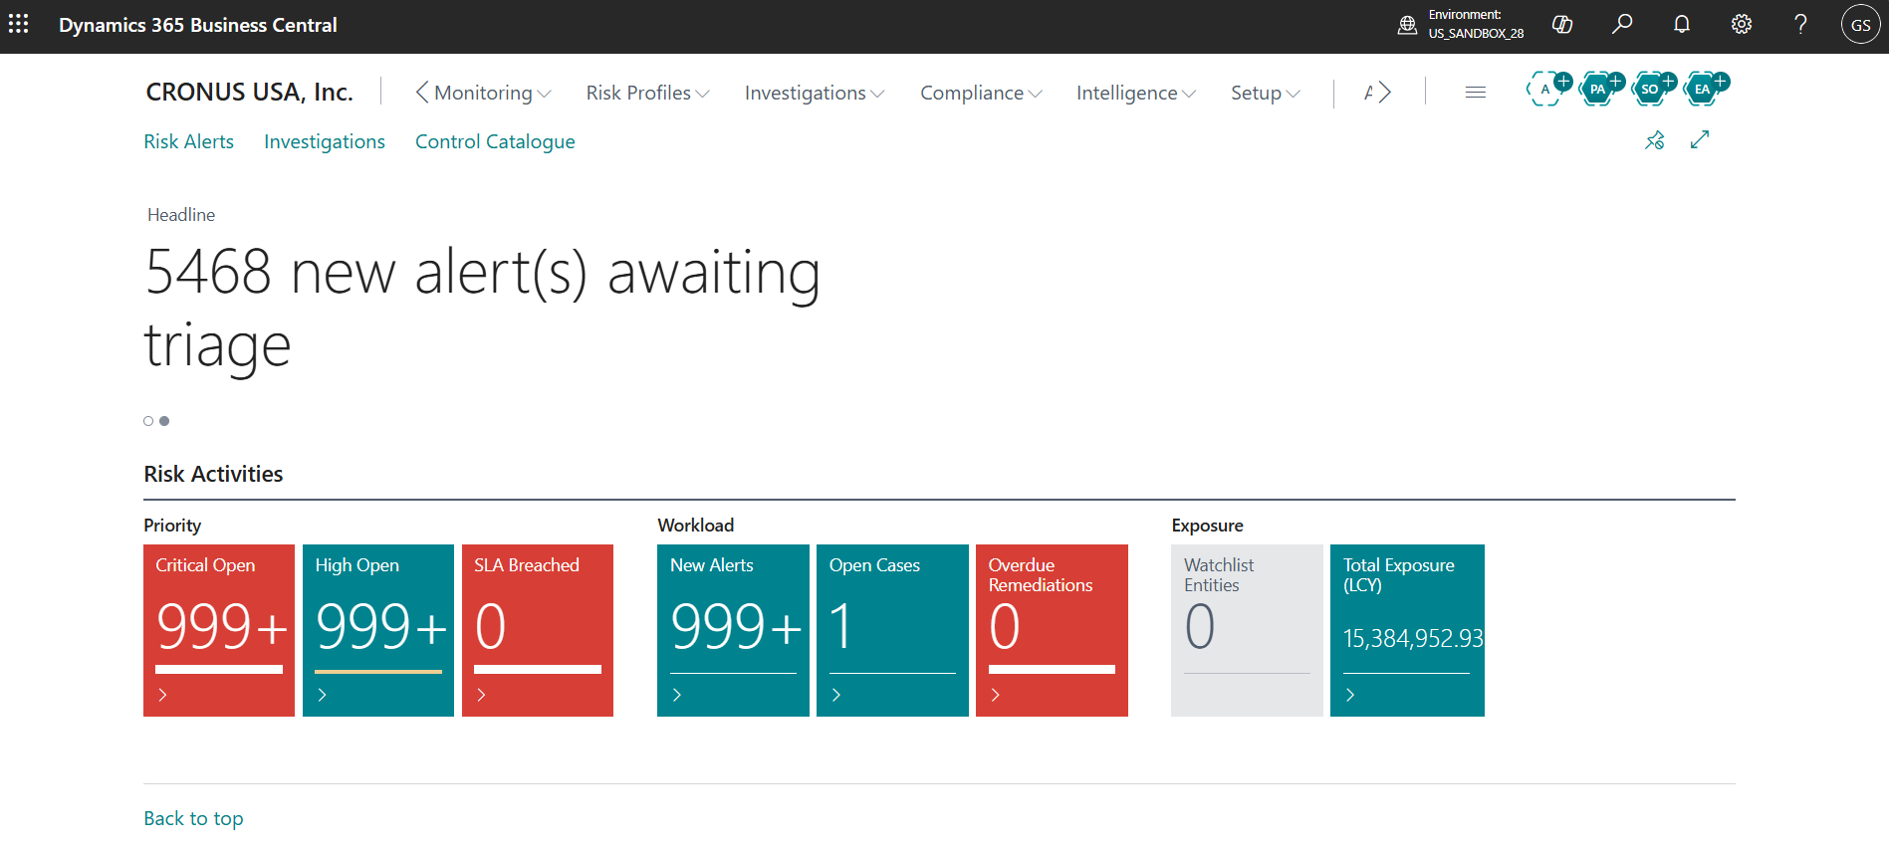
THE NATIVE EXPERIENCE
Inside Business Central
AL Extension embedded directly in the daily Finance workflow — no additional portal required
[ ROLE CENTER SCREENSHOT ]
RIA Intelligence Dashboard — Finance Role Center
Gokulnath Sundaramoorthy · Microsoft Dynamics 365 Business Central Solution Architect · v1.0 · June 2026

Slide 7
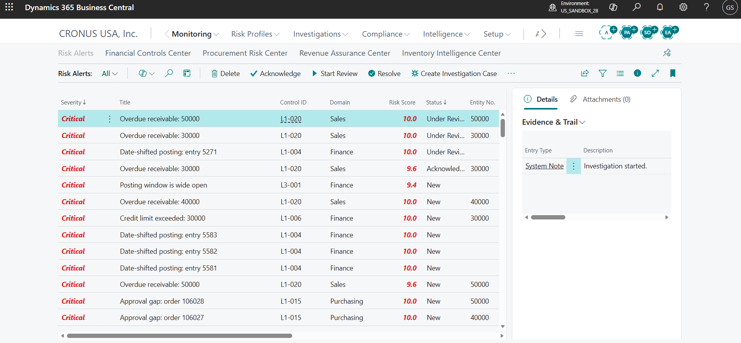
THE NATIVE EXPERIENCE
Alert Management & Triage

Slide 8
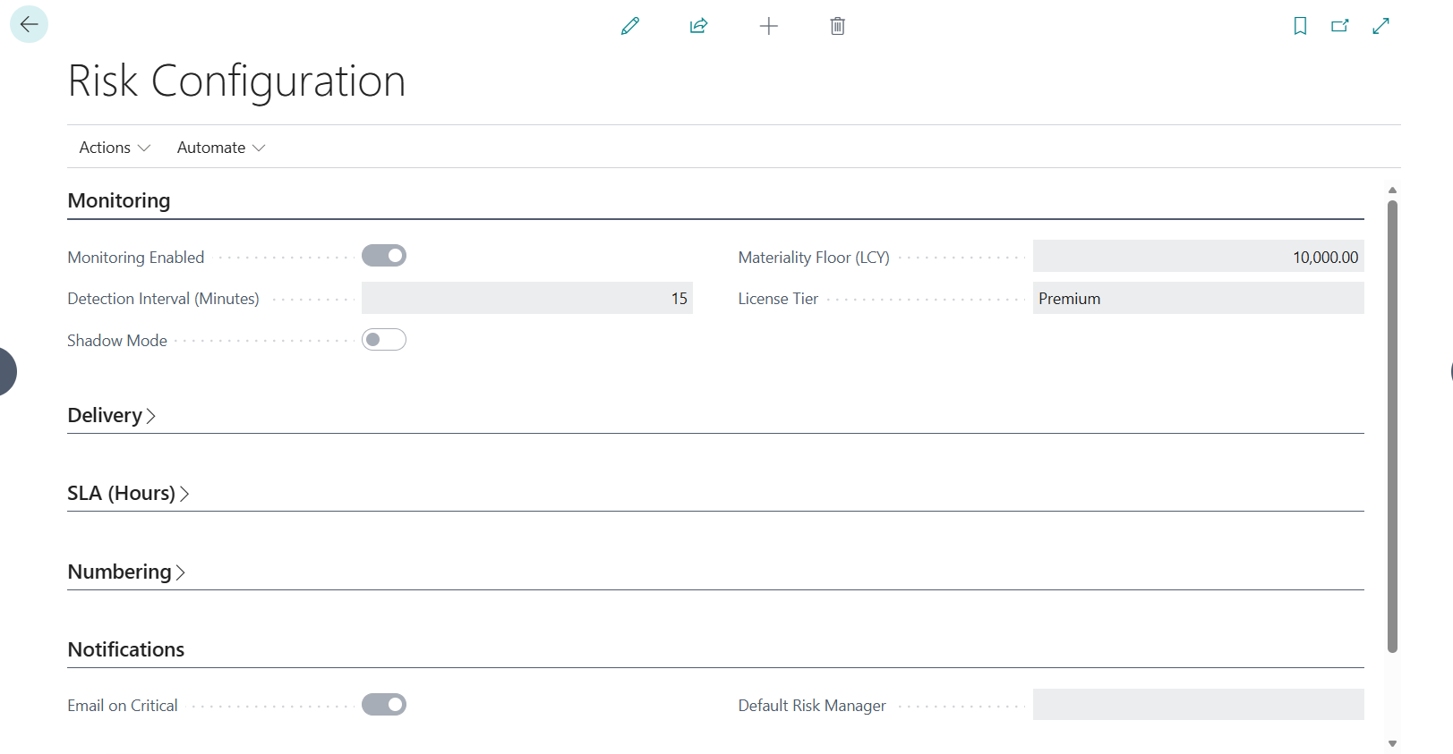
THE NATIVE EXPERIENCE
Risk Setup & Configuration

Slide 9
HOW IT WORKS
From Business Central to Intelligence
Seven steps — data to alert — running continuously in Microsoft Azure
1
2
3
4
5
6
7
BC Data
Fabric Lake
Rule Engine
ML Models
AI Explain
Alert Delivery
Act & Improve
REST API v2.0
& Webhooks
Bronze / Silver
/ Gold Layers
100+ Configurable
Controls
Anomaly Scoring
& Prediction
GPT-4o + RAG
Grounded Response
BC · Teams
Email · API
Resolve · Learn
· Model Improves
< 5 min detection for critical controls · 15-min incremental data sync · 99.9% uptime SLA · Zero ERP performance impact
Gokulnath Sundaramoorthy · Microsoft Dynamics 365 Business Central Solution Architect · v1.0 · June 2026

Slide 10
HIGH-LEVEL ARCHITECTURE
Cloud-Native on Microsoft Azure
Zero direct BC database access · Per-tenant data isolation · SOC 2 Type II · GDPR compliant
Business Central
Azure Data Layer
Intelligence Engine
Delivery & Access
REST API v2.0+ / OData
Microsoft Fabric Lakehouse
Configurable Rule Engine
BC Role Center (AL)
Webhook Subscriptions
→
Azure Data Factory (ADF)
→
Azure Machine Learning
→
Power BI Dashboards
OAuth 2.0 + Azure AD
Bronze / Silver / Gold
GPT-4o + RAG (Azure OAI)
Microsoft Teams Alerts
AL Extension (Presentation)
7-Year Audit Retention
Azure Service Bus
REST API Webhooks
Gokulnath Sundaramoorthy · Microsoft Dynamics 365 Business Central Solution Architect · v1.0 · June 2026

Slide 11
PRODUCT ROADMAP
Four Phases to Full Intelligence
Phase 1
Phase 2
Phase 3
Phase 4
MVP · Now
Year 1 · H2
Year 2 · Q1–Q2
Year 2 · Q3–Q4
Phase 1 · MVP · Now
Phase 2 · Year 1 · H2
Phase 3 · Year 2 · Q1–Q2
Phase 4 · Year 2 · Q3–Q4
26 L1 Controls — Finance, AP, AR, Inventory
Complete 44 L1 Controls
L3 Configuration Intelligence
L5 Predictive Intelligence (all 7 models)
Risk & Finance Copilots (AI Agents)
All 6 AI Copilot Agents
L4 External Market Intelligence
Australia & Canada Compliance
UK & India Compliance Frameworks
L2 Process Intelligence (P2P, Q2C, R2R)
USA, Saudi Arabia & UAE Compliance
Microsoft Co-Sell Activation
BC Role Center + Power BI Dashboard
Teams Integration + Alert Management
Enterprise Tier + Custom Control Builder
Power Platform + API Integration
Gokulnath Sundaramoorthy · Microsoft Dynamics 365 Business Central Solution Architect · v1.0 · June 2026

Slide 12
WHY CHOOSE RIA?
The Only 5-Layer Intelligence Platform for Business Central
Purpose-built depth that no Microsoft-native feature or generic AI tool replicates
Without RIA
With RIA
✕ Risk exposures surface months after they have already occurred
✓ Critical anomalies surfaced in under 5 minutes via real-time monitoring
✕ Audit preparation consumes weeks of manual evidence gathering
✓ Audit-ready evidence packages generated on demand in minutes
✕ ERP configuration drift goes undetected until damage is done
VS
✓ Real-time configuration change detection with immediate escalation
✕ No external market signals connected to your ERP environment
✓ L4 External Intelligence connects your ERP to real-world signals
✕ No predictive intelligence layer to pre-empt financial exposure
✓ L5 ML models identify emerging risk weeks before financial impact
✕ Generic AI with no grounding in your actual BC transaction data
✓ Six role-specific Copilots grounded in your actual Business Central data
Gokulnath Sundaramoorthy · Microsoft Dynamics 365 Business Central Solution Architect · v1.0 · June 2026

Slide 13
Thank You
Questions & Discussion
Gokulnath Sundaramoorthy
Senior Lead Consultant — Microsoft Dynamics 365 Business Central
✉ Email: Gokulssv@yahoo.com
🔗 LinkedIn: [linkedin.com/in/Gokulssv]

